Slide 1


Penn Liberty Motors
Safety Features

Slide 2
Safety Features Standard on All Vehicles
Seat belts
Rear seat head restraints
Head injury protection
Seat belt reminder system
Traction control

Slide 3
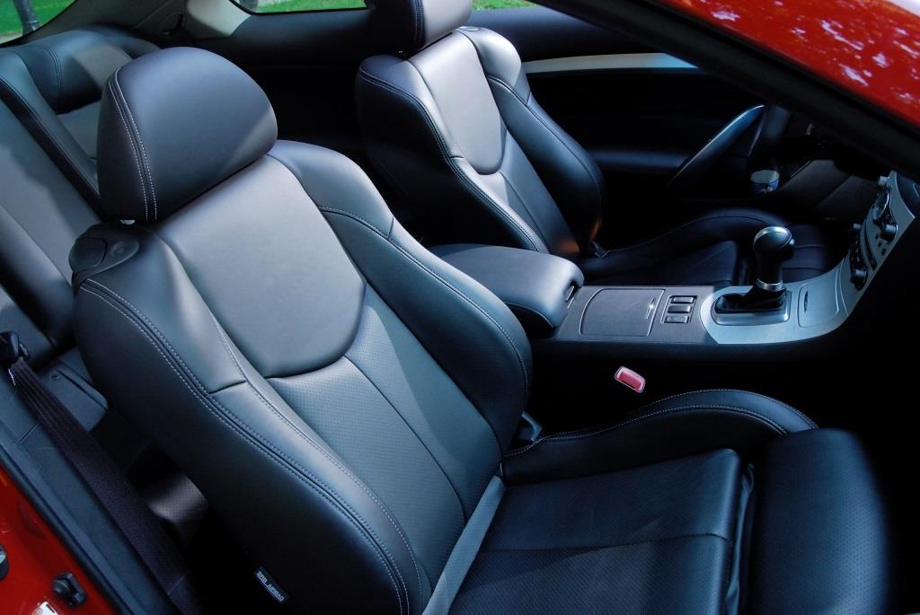
Head Injury Protection
Foam/energy absorbing material under vehicle interior trim
Head restraints (front and rear seat)
Adjustable
Meet federal requirements

Slide 4
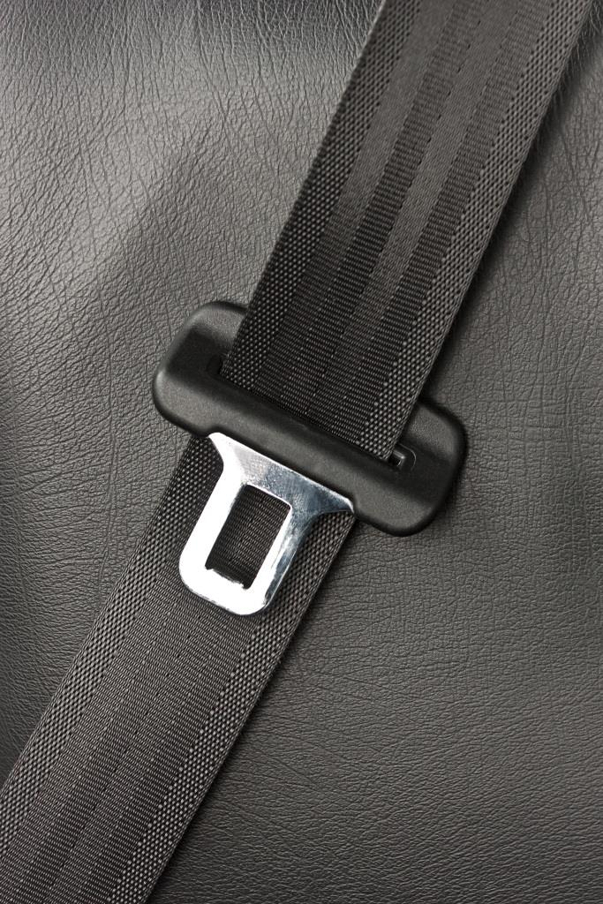
Seat belts
Adjustable upper belts
Seat belt pretensioner
Energy management features
Integrated seat belt systems
Rear center seat lap/shoulder belts

Slide 5
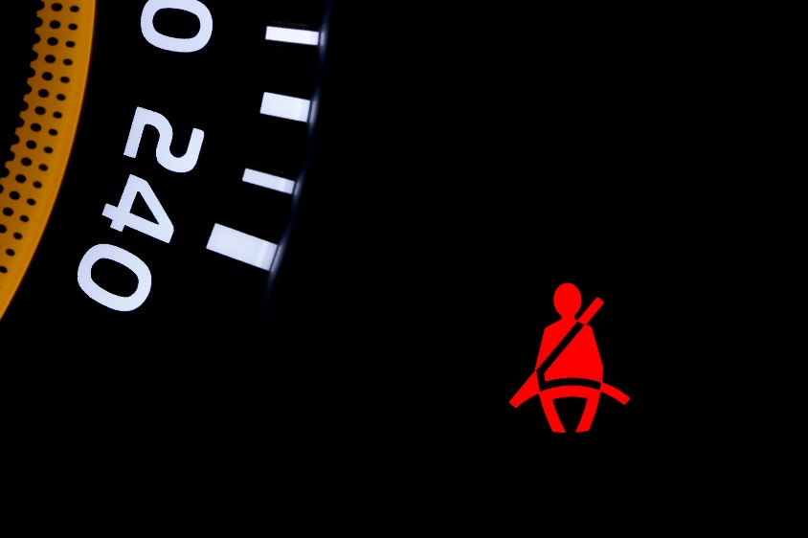
Seat belt Reminder System
Reminds occupants to wear seat belts
Appears as warning light on dashboard
Makes audible sounds
Increases warning intensity based on speed

Slide 6
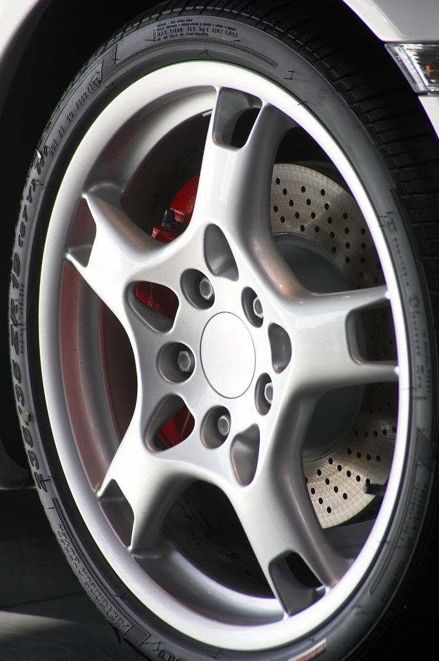
Traction Control System
Improves vehicle stability
Controls drive wheel slippage
Adjusts engine power output
Applies braking force to selected wheels

Slide 7
Safety Features on Selected Vehicles
All-wheel drive
Auto-dimming rear-view mirrors
Daytime running lights
Advanced frontal airbag system
Electronic stability control (ESC)
Side-impact airbags (SAB)
Tire pressure monitoring system (TPMS)

Slide 8
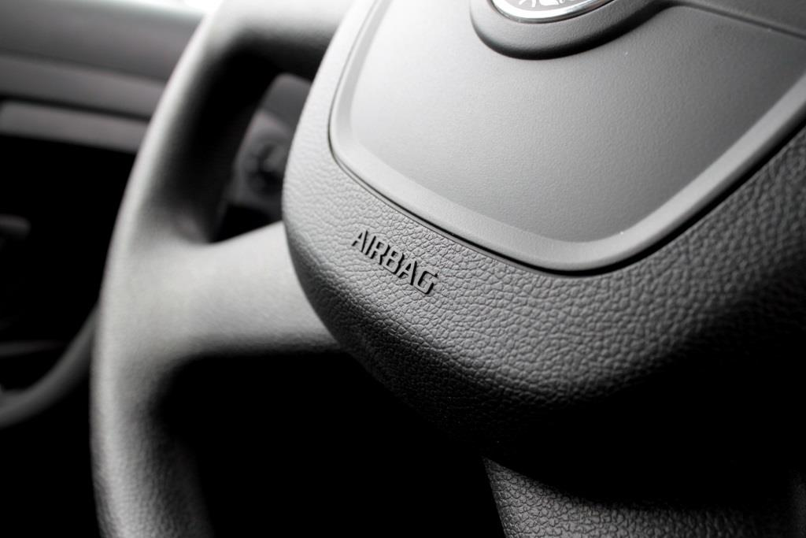
Advanced Frontal Airbag System
Built–in sensors detect
Severity of the crash
Occupant’s size
Seat belt use
Seating position
Deploys appropriate level of power
Includes on-off switch

Slide 9

Automatic Dimming Rear-View Mirrors
Automatically darken
Dim gradually
Reduce glare from rear-approaching vehicles

Slide 10
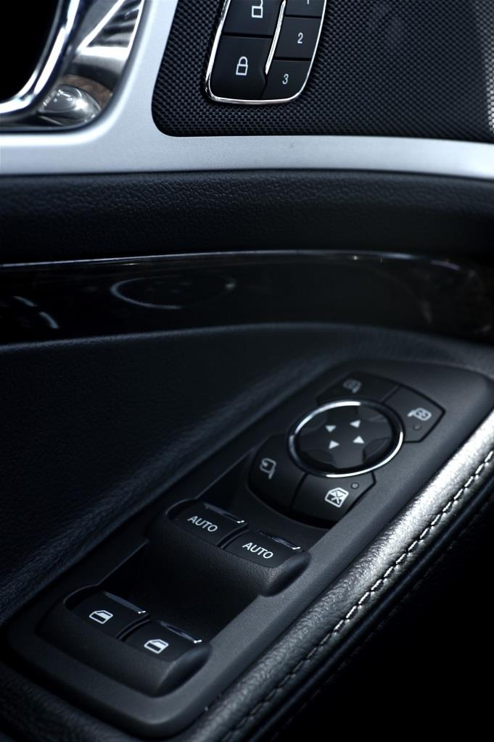
Electronic Stability Control (ESC)
Maintain vehicle control
Slippery roads
Extreme steering maneuvers
Contains automatic sensor
Prevents
Spinning out (oversteering)
Plow out (understeering)

Slide 11
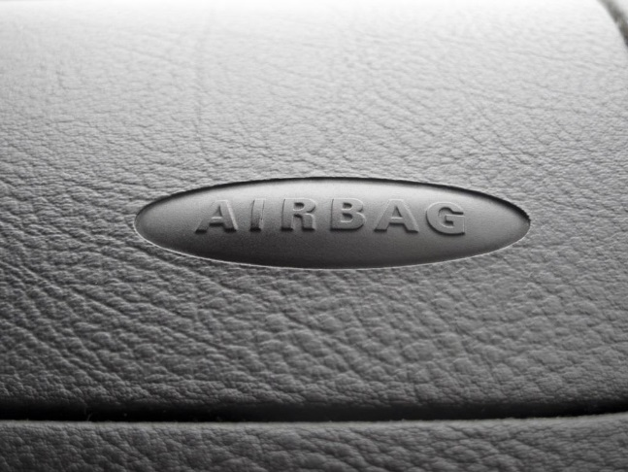
Side-Impact Airbags (SAB)
Curtain / tubular
Combo
Additional protection
Head
Chest

Slide 12
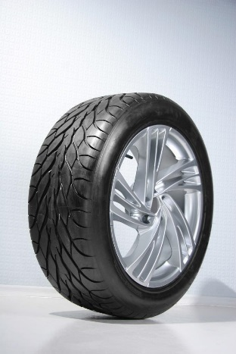
Tire Pressure Monitoring System (TPMS)
Dashboard warning light
Underinflated tire(s) alert if 25% below recommended inflation pressure

Slide 13

Penn Liberty Motors Safety Team
Assembled to test safety equipment
Available to customers
Email Your Concerns

